Slide 1
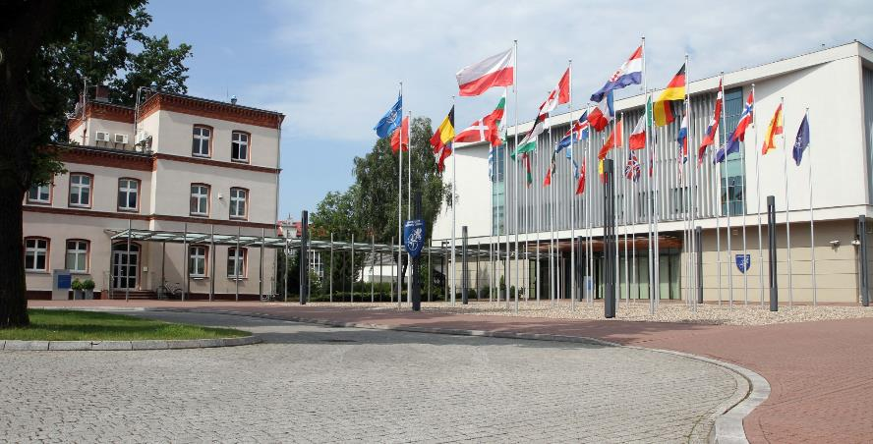
2026 JTLS-GO International Working Group
VERSION 1.1
19 MAY 26
Briefer: G15 Ioannis PAPANIKOLAOU, MBA, MSc IT
The overall classification of this presentation is: NATO UNCLASSIFIED

Slide 2
AGENDA
JFTC’s Role within NATO
JFTC Organizational Structure and Mission
LOLE26 Key Facts and Overview
JTLS Challenges during LOLE26
Proposed JTLS Improvements and Enhancements
Notes:
JFTC’s Role within NATO JFTC Organizational Structure and Mission LOLE26 Key Facts and Overview JTLS Challenges during LOLE26 Proposed JTLS Improvements and Enhancements

Slide 3
JFTC IN NATO
NATO
Brussels, Belgium
International Military Staff (IMS)
International Staff (IS)
Allied Command Operations (ACO)
Mons, Belgium
Allied Command Transformation (ACT)
Norfolk, USA
Joint Warfare Center (JWC)
Stavanger Norway
Joint Force Training Center (JFTC)
Bydgoszcz, Poland
Joint Analysis and Lessons Learned (JALLC)
Monstanto-Lisbon, Portugal
Joint Analysis, Training and Education Centre (JATEC) Bydgoszcz, Poland

Slide 4
JFTC ORGANISATIONAL STRUCTURE
COM JFTC
DCOM/COS
BUDFIN
OPA
OLA
DOM
Staff Adv. Group
Headquarters Support Division
Security Branch
Exercise Content & Planning Branch
All Domain Integration Branch
C4/ Modelling and Simulation Branch
Concept, Capability Integration and Experimentation Branch
Training Analysis and Quality Assurance
HRM Support Branch
Base Support Branch
Management, Taskin, Coordination Branch
Plans and Programs Branch
Protocol and conference support
IKM/CR Branch
Training and Exercise enabling Division (TEED)
Training and Exercise Division (TED)

Slide 5

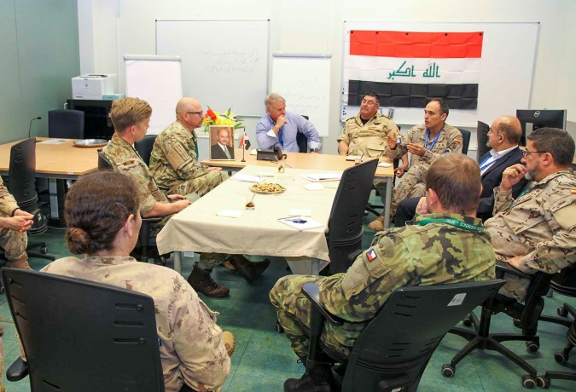


JFTC's MISSION
SUPPORT TO CURRENT OPERATIONS
SUPPORT TO WARFARE DEVELOPMENT
SUPPORT TO FUTURE OPERATIONS
JFTC
JFTC
JFTC
JFTC

Slide 6
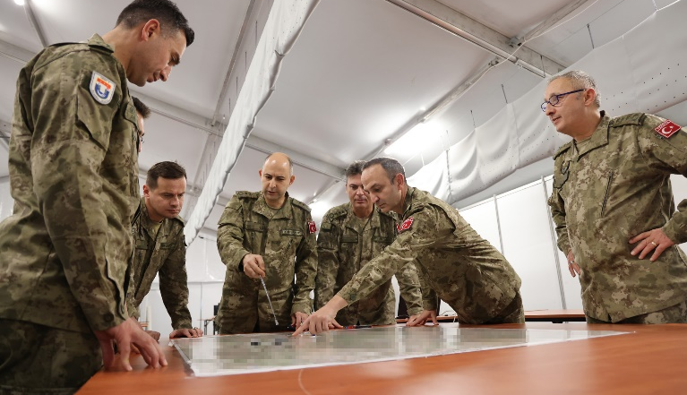
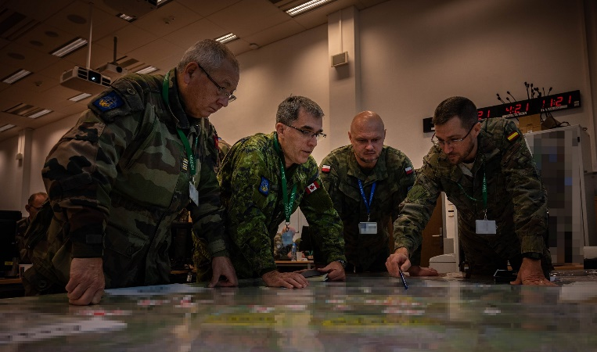
SUPPORT TO FUTURE OPERATIONS
NFS-NATO FORCE STRUCTURE
NCS-NATO COMMAND STRUCTURE

Slide 7
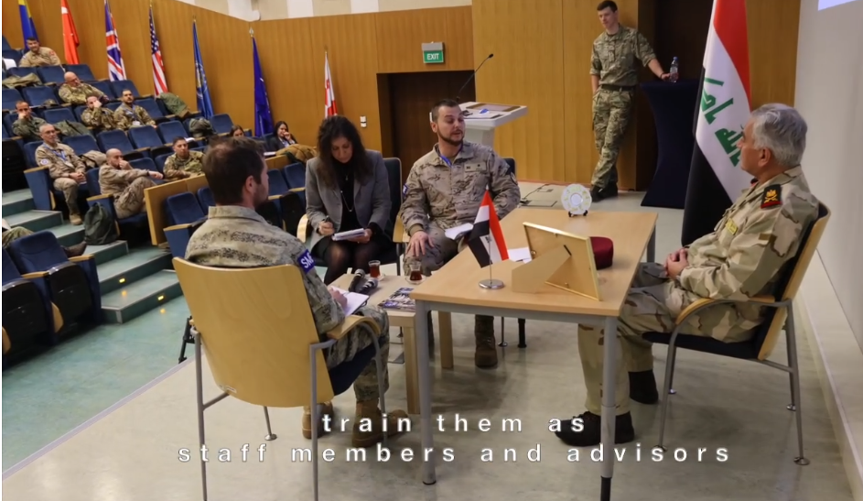
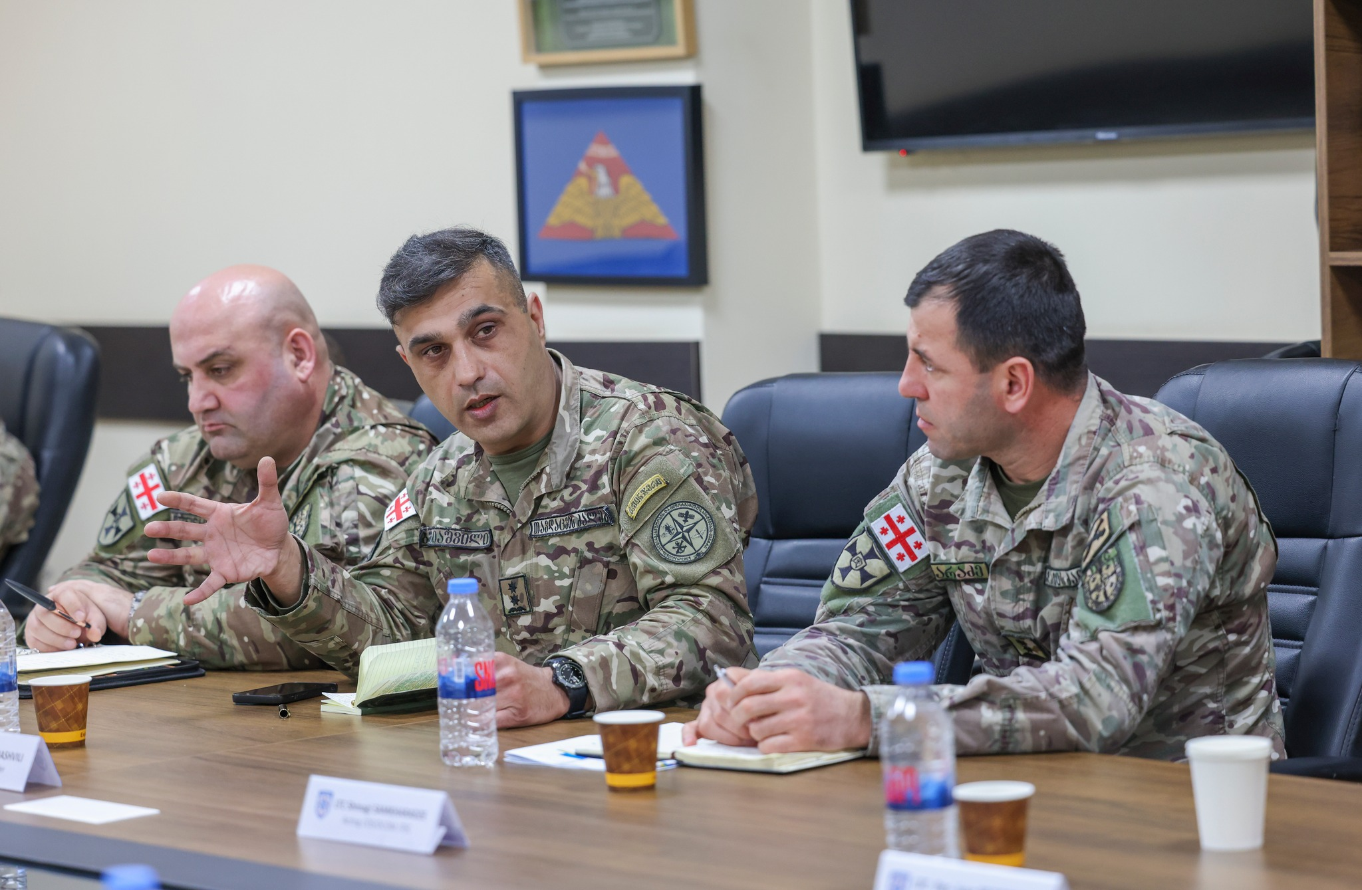
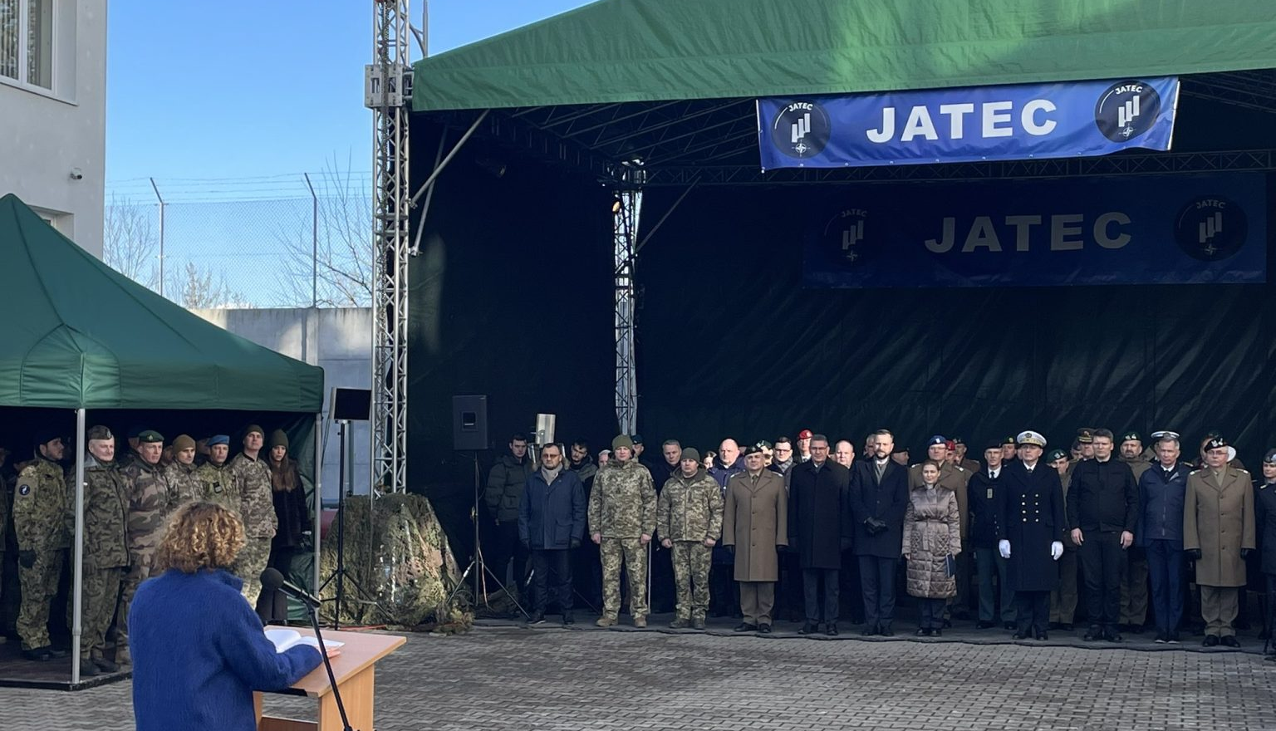




SUPPORT TO CURRENT OPERATIONS and PARTNERSHIPS
Pre-deployment training events for
NATO Mission Iraq
(NMI-PDT)
Partnership - NATO-GEO Joint Training and Evaluation Centre (JTEC)
Mobile Training Team Ukraine
(MTT Ukraine)
JATEC
Joint Analysis, Training and Education Centre supported by JFTC

Slide 8

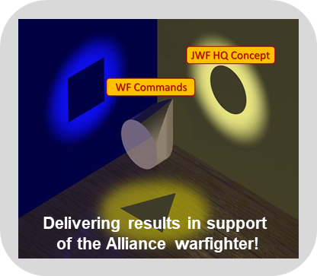
SUPPORT TO WARFARE DEVELOPMENT
Warfare Development
Innovation
Tests & Experimentation
Lessons Learned
Concept Validation
Doctrine
Experimentation in Exercises
Allied Joint Publication Doctrine Management
Directed Innovation

Slide 9
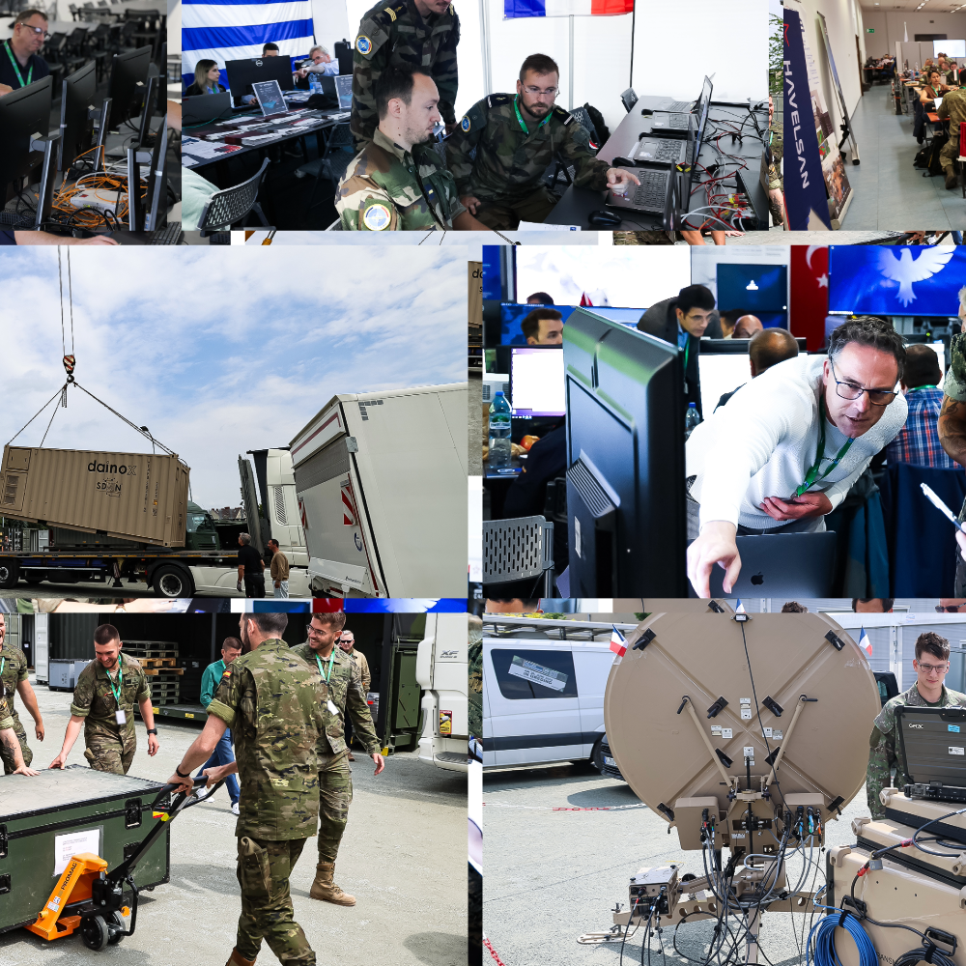
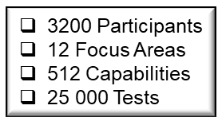
CWIX – NATO’s LARGEST INTEROPERABILITY EXERCISE
NATO UNCLASSIFIED

Slide 10
LOYAL LEDA 26 (LOLE26)
Key Facts and Overview
LOLE26 was a LANDCOM-scheduled land-centric CAX/CPX in a multi-domain environment that seek to train and evaluate two Warfighting Corps HQ role and two additional Corps at MJO scale, against a peer adversary and non-linear threats contesting NATO in crisis and conflict in region Centre.
EXCON was in JFTC while PTA/STA trained from their home locations (distributed).
It was OPFOR driven
Merged with Ramstein Ambition 2026 (RAAM26)
24h/5days followed by a 12h/4days Dynamic phase

Slide 11
LOYAL LEDA 26 (LOLE26)
Key Facts and Overview
JFTC CAX team participated in all preparatory conferences (IPC, MPC, FCC) and some intermediate
JFTC CAX Team developed the JTLS DB based on details (e.g ORBAT, systems) from Training Audiences.
Before the event a DB validation workshop was conducted in parallel with the MEL/MIL Scripting workshop, at JFTC.
TA JTLS operators were trained in their home locations, while OPFOR and other HICON operators at JFTC, 2 weeks prior STARTEX.

Slide 12
Loyal Leda 26 JTLS DB Trivia
UNITS | 5836
TARGETS | 14448
MINEFIELDS | 985
AOR | 600000 sq.km²

Slide 13

Loyal Leda 26 Technicalities
 | Server Configuration | Client Configuration
CPU | 48 x 2.1 Ghz | 2.7 GHZ
RAM | 192 GB | 16 GB
Total Number | 6 (VM) | 165

Slide 14
Case:Loyal Leda 26 JTLS UAV Swarm
Initial testing modelled drones as TBMs. The system handled approximately 100–150 simultaneous launches.
Follow-on testing modelled drones as cruise missiles, which placed significantly lower stress on the system. Scenarios with up to 3,000 launches were executed.
Scheduled launch and Time-on-Target (ToT) scenarios were tested. In ToT scenarios, where 1,500–3,000 drones impacted 50 different targets simultaneously, the system experienced a minor processing delay of approximately 15–30 seconds during damage and casualty calculations.
The simulation playbox used 5-minute grids with 1-minute shoreline grids. This reduced drone density per grid cell and lowered system load during swarm simulations.

Slide 15
JTLS Challenges during LOLE266
OBSERVATION | SOLUTION
The system generated Warning 1900s due to excessive units concentrated within a single grid. This congestion significantly increased model load times, indicating that the grid setup was too coarse for the unit density. | The LOLE26 map was rebuilt on another server using the recommended configuration. The grid definition was refined to better distribute units and reduce congestion. This aligned the database with performance best practices and reduced model startup time to about 15 minutes, confirming grid density as the root cause.
Creating a UAV swarm caused significant slowdowns. The issue was traced to UAVs being configured as ballistic, which increased computational load when handling large numbers of entities. | The UAVs were reconfigured from ballistic to cruise, reducing trajectory and swarm-processing complexity. Performance returned to normal, confirming the UAV type configuration as the root cause.
19 MAY 2026 | PAGE 15

Slide 16
JTLS Challenges during LOLE266
OBSERVATION | SOLUTION
Game speed displays were inconsistent across interfaces. While the CEP showed the correct speed (7), the Controller WHIP remained at 0 and the dashboard showed 1.0, creating uncertainty about the simulation state. The WHIP display did not update even after several minutes. | Restarting the JXSRs and restarting the WHIP restored the correct game speed display across all interfaces. Although effective, this required a disruptive restart during the exercise.
19 MAY 2026 | PAGE 16
Notes:
Solution:

Slide 17
Proposed JTLS Improvements
and Enhancements
OBSERVATION | SYSTEM IMPROVEMENT RECOMMENDATION
When a unit is moved to a new HQ through a move order, command and control authority remains with the original HQ instead of transferring automatically to the receiving HQ. This creates coordination burdens and increases the risk of unclear or delayed command relationships during fast-paced operations. | It is recommended that control authority automatically transfers to the receiving HQ when a move order is executed. This would reduce manual intervention, improve command agility, and streamline force management during complex operations.
It was observed that AAR-ORDER output files can become very large during extended runs, making them difficult to manage with standard office tools. Although sorting by column is supported, the lack of filtering limits efficient analysis and forces users to work through the full dataset even when only a subset is needed. | It is recommended that column-based filtering be added to AAR-ORDER outputs alongside existing sorting options. This would allow users to isolate relevant data more easily, improve analysis efficiency, and reduce reliance on external data-processing tools.
19 MAY 2026 | PAGE 17

Slide 18
Proposed JTLS Improvements
and Enhancements
OBSERVATION | SYSTEM IMPROVEMENT RECOMMENDATION
It was observed that combat system availability figures in the IMT are not always updated correctly after Combat Power is modified through game controller actions. In some cases, manned and available quantities displayed as zero while casualty figures still showed personnel losses, indicating a synchronization issue between availability and casualty data. | It is recommended that combat system availability values be automatically recalculated whenever Combat Power is adjusted through control actions. This would improve data accuracy, reduce operator confusion, and ensure more reliable unit status reporting during operations and post-run analysis.
It was observed that the Single Combat System field in the DAMAGE.COMBAT.SYSTEMS and CHANGE.CS.MAINTENANCE forms displays all combat systems in the database, rather than only those assigned to the selected unit. This increases workflow complexity and the risk of selection errors. | It is recommended that the selection list be filtered to show only combat systems associated with the selected unit. This would improve usability, reduce incorrect data entry, and better align the interface with user expectations.
19 MAY 2026 | PAGE 18

Slide 19
Proposed JTLS Improvements
and Enhancements
OBSERVATION | SYSTEM IMPROVEMENT RECOMMENDATION
Assessment of combat power within a defined geographic area is currently performed manually through unit and spatial analysis, making the process time-consuming and error-prone in large or dynamic scenarios. | Introduce a Correlation of Forces and Means reporting capability to automatically compare opposing forces within a user-defined area and improve situational awareness, operational planning, and after-action analysis.
JTLS installation on Red Hat Linux requires multiple manual steps and is prone to configuration and deployment errors. | Provide RPM-based installation packages to standardize deployment, reduce manual actions, and improve installation reliability and maintainability on Red Hat Linux systems.
19 MAY 2026 | PAGE 19

Slide 20

Questions

Slide 21
Contact us
E-MAIL
Ioannis PAPANIKOLAOU, ioannis.papanikolaou@nato.int
PHONE
+48 261 411 507 (office)
+48 261 411 424 (JFTC)

